Slide 1

Word Study
Gregory Crane, Anna Krohn, 2015

Slide 2
English to Greek/Latin
Investigating English concepts and their Greek/Latin counterparts
or
Does this really mean what I think it means?

Slide 3
Choose a word
“Pollution”

Slide 4
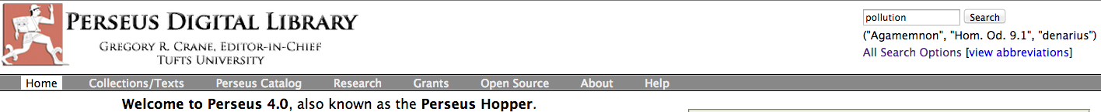
Search
Notes:
-Enter the word in the top search box.

Slide 5
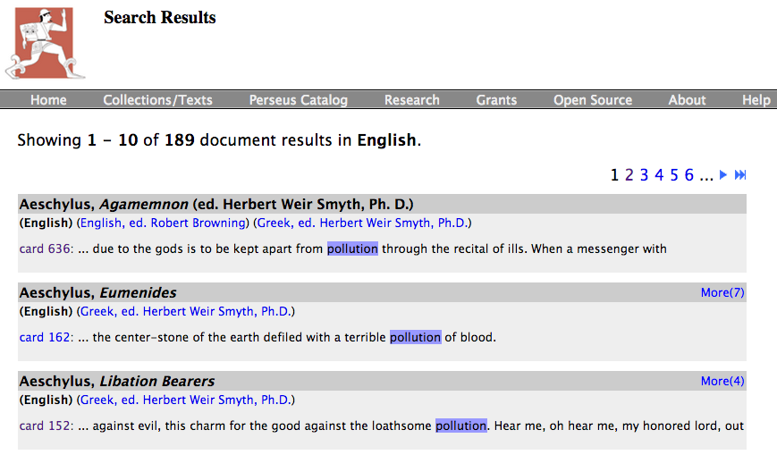
Browse and choose
Notes:
-Results will display in this manner, works sorted by author.
-Click on the “More” links to see other instances of the word within a work.
-Click on the “card” link to go to the page for the work.

Slide 6
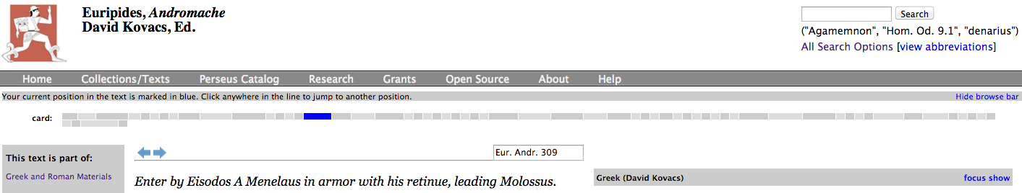
Get the original text
Notes:
-To see the Greek/Latin for the English text, click on “show.”

Slide 7
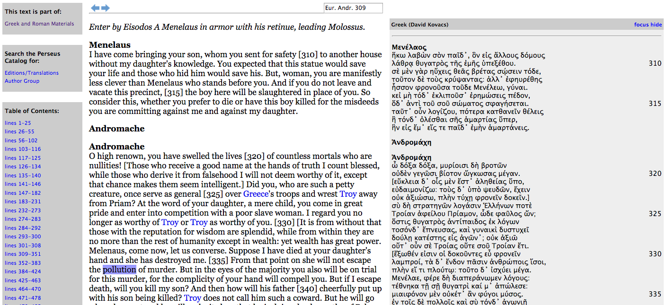
Get the original text
Notes:
-This is what the side-by-side display looks like. The search word should be highlighted.

Slide 8
Find the word
Notes:
-Locating the Greek or Latin is the hardest part. Some tips to narrow down your search area:
-Use line numbers to orient [red boxes]
-Use names to orient (In Greek the names should be the only capitalized words) [orange boxes]
-Click on Greek/Latin words to see their definitions

Slide 9
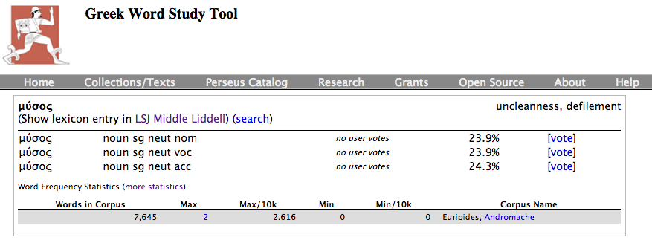
Definition
Notes:
-Definitions frequently won’t be the exact word, but in this case, pollution == defilement
-Sometimes definitions are gibberish, in which case the lexicon entry is needed
-To see any more info on the word, click on the “LSJ” link (or for Latin, “Lewis & Short”)

Slide 10
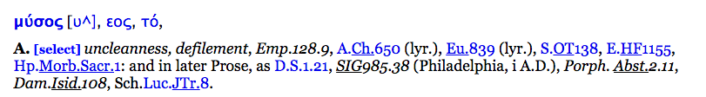
Definition
Notes:
-This is an entry in the LSJ, not too much more information here, see the Using Perseus presentation for a more complex example

Slide 11
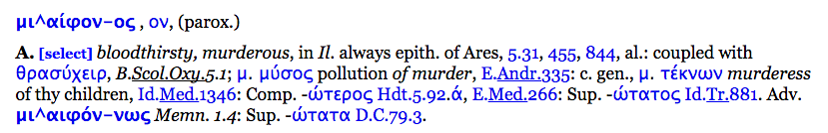
Context
Notes:
-μύσος here is linked to murder
-the phrase μιαιφόνον...μύσος is cited as meaning “pollution of murder” based on this text
-is this word always linked with murder? Does it appear with it?

Slide 12
Other contexts
Notes:
-To see other instances of the Greek/Latin word in other works, see the Word Frequency Statistics

Slide 13
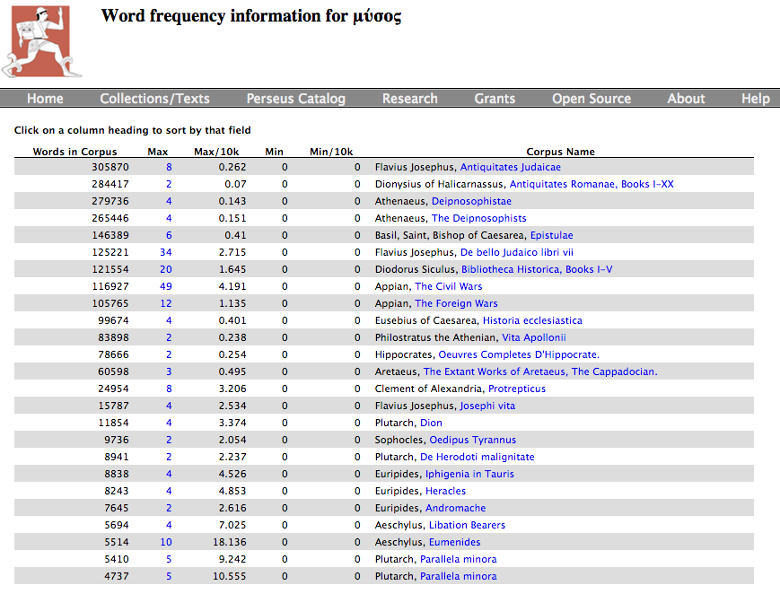
Other contexts
Notes:
-The results give you a list of works and tell you how many times (in the Max column) the word appears in each work, click on that number to see the instances of the word.

Slide 14
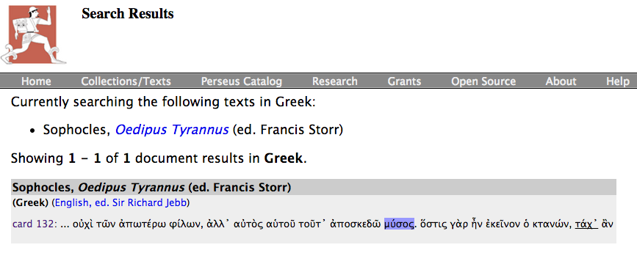
Other contexts
Notes:
-Further work reveals that Oedipus here is talking about “dispelling this taint,” which is of course the murder of his father.
-Looking at other texts shows that μύσος is generally a pollution related to death.

Slide 15
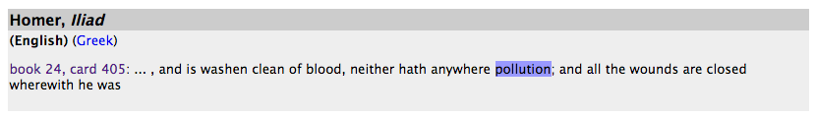
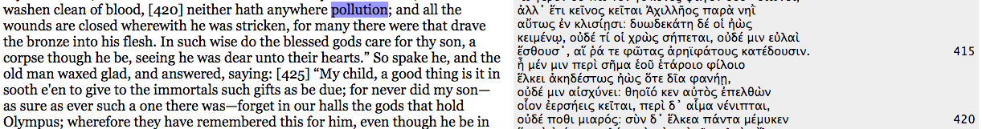
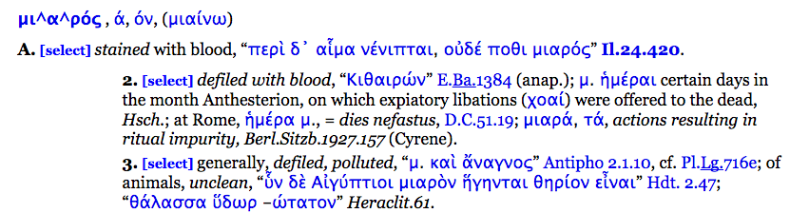
Repeat
Notes:
-Return to the list of instances of “pollution” to find another word and repeat the process.

Slide 16
Analyze
μύσος => pollution via death/murder
μιαρός => pollution via blood
Notes:
-This is a small demonstration that multiple words in Greek/Latin can map to the same English word, but they have rather different connotations. Only through exploring and looking into things can non-language students even begin to know this.

Slide 17
Greek/Latin through the corpus
Investigating the appearance and use of Greek/Latin words through time
or
How did this word come to mean that?

Slide 18
Choose a word
ἀγάπη
“love”
Notes:
-ἀγάπη, or love, a common word in the Greek New Testament.

Slide 19
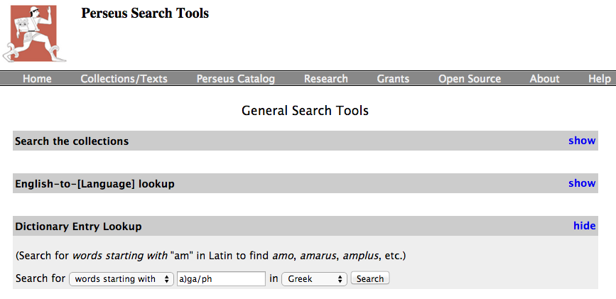
Look it up
Notes:
-http://www.perseus.tufts.edu/hopper/search, see the sidebar on the same page on how to enter in Greek

Slide 20
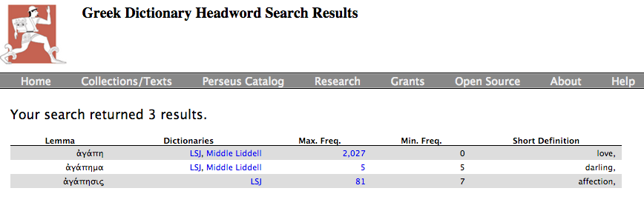
Select a result
Notes:
-Click on the word to go to the dictionary.

Slide 21
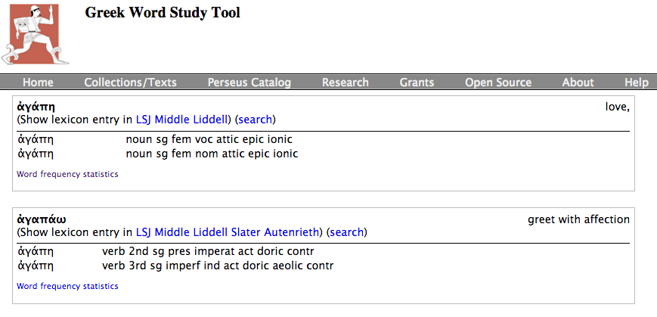
Dictionary
Notes:
-Click LSJ (Or Lewis & Short for Latin)

Slide 22
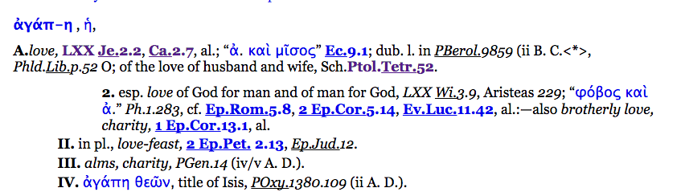
Dictionary
Notes:
-ἀγάπη => love, love of a husband and wife, love of God, brotherly love, alms… Clearly most meanings are taken from Christian writings.
-But if all of these are Christian, what was the word before?

Slide 23
Dig a little deeper
Notes:
-Click word frequency statistics

Slide 24
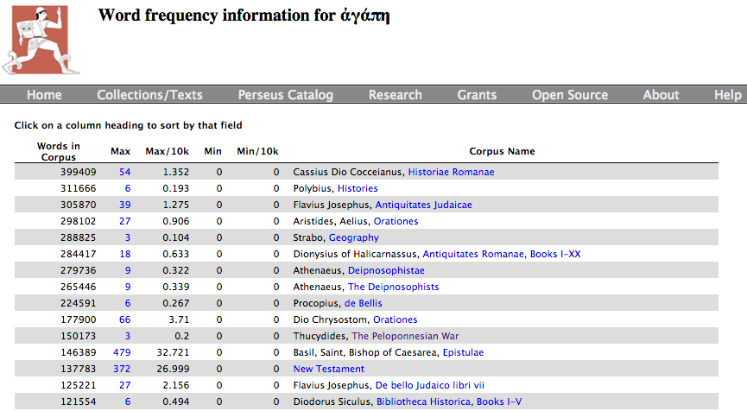
Dig a little deeper
Notes:
-Let’s deliberately look at a pre-Christian author...

Slide 25
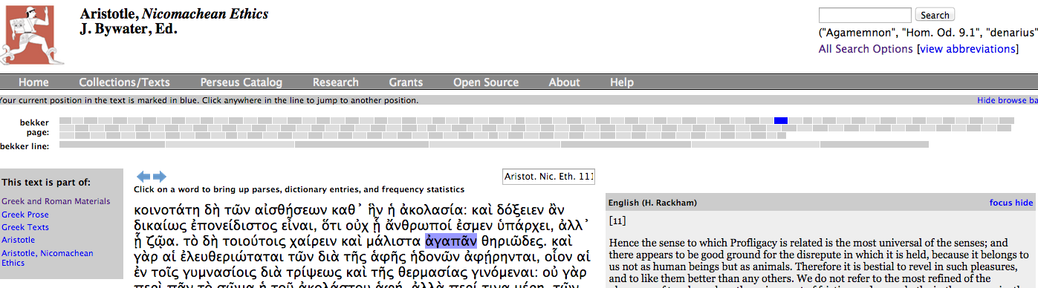
Context
Notes:
-“Therefore it is bestial to revel in such pleasures”
-Aristotle here is talking about extravagance and how to over do things in animalistic. The word for “pleasures” here is ἀγαπᾶν, which is “to greet with affection.” This isn’t exactly ἀγάπη, but it is coming from an idea of love or desire
-This isn’t the best example of a word changing meaning, but it does show an evolution of related words, ἀγάπη is a Christian term that came out of ἀγαπάω

Slide 26
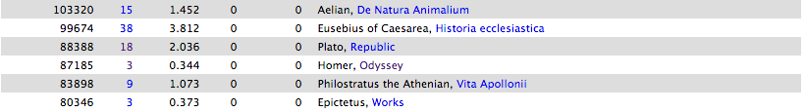
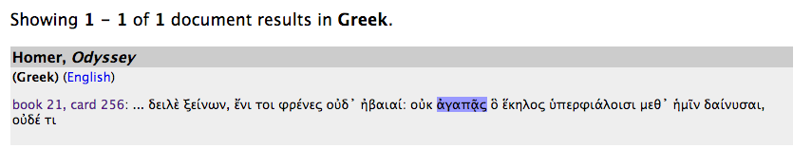

Repeat

Slide 27
Analyze
ἀγαπάω => greet with affection, be fond of, desire, be content, etc….
(largely Christian) ἀγάπη => love, love of a husband and wife, love of God, brotherly love, alms, etc….
Can easily see where ἀγάπη comes from but takes on its specific meaning that even gets carried out of Christian texts.
e.g. ἀγάπη θεῶν, title of Isis, found in the Oxyrhynchus Papyrus 1380.109 (from 2nd c. C.E.)
Notes:
-Papyrus link: http://clp.classics.ox.ac.uk/v0011/1380.htm

